Slide 1

Microsoft Business Application
Lecture 3: Extend finance and operations apps

Slide 2
Extend finance and operations apps
Explore extensions and the extension framework in finance and operations apps
Extend elements in finance and operations apps
Consume business events in finance and operations apps

Slide 3
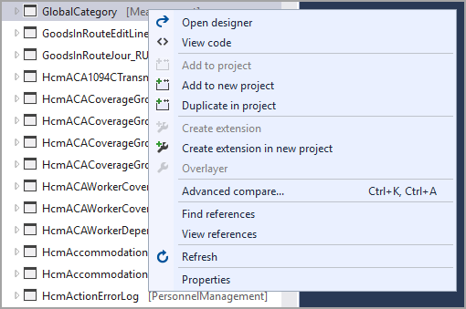
1. Explore extensions and the extension framework in finance and operations apps
Finance and operations apps are customized by using extensions, which let you add functionality to model elements and source code in the Application Object Tree (AOT) by using Visual Studio.
1.1 Introduction
Intrusive customizations should be avoided because they can impact upgrade costs and introduce instability.
Extensions should be used to customize finance and operations apps whenever possible.
1.2 Customization models
Extensions are preferred over overlaying because they are easier to maintain and upgrade.
Overlaying can lead to code conflicts and make it difficult to upgrade to newer versions of the application.
Extension models can be created by using the Create model wizard. In the Select package window, select the Create a new package option instead of Select existing package.

Slide 4
1.3 Extension points for frameworks
When a change needs to be propagated through the entire application, you should create an extension of that element to modify properties or components.
The following is an overview of common element types and the reasons for creating an extension of an element:
Labels can be extended to modify the values of a label, add new labels, or add new languages.
Enumerations (enums) can be extended to add new values to them.
Extended data types (EDTs) can be extended to modify properties such as the label, string size, or help text.
Tables can be extended to add new fields, indexes, or relations, as well as modify properties for the table elements or the table.
Data entities can be extended for many of the same reasons as tables and can also be extended to add data sources.
Forms can be extended to add a new data source, add a new control, or modify properties such as labels, help text, and captions.
Menus can be extended to add new menu items, submenus, or menu references or to hide any of these items.

Slide 5
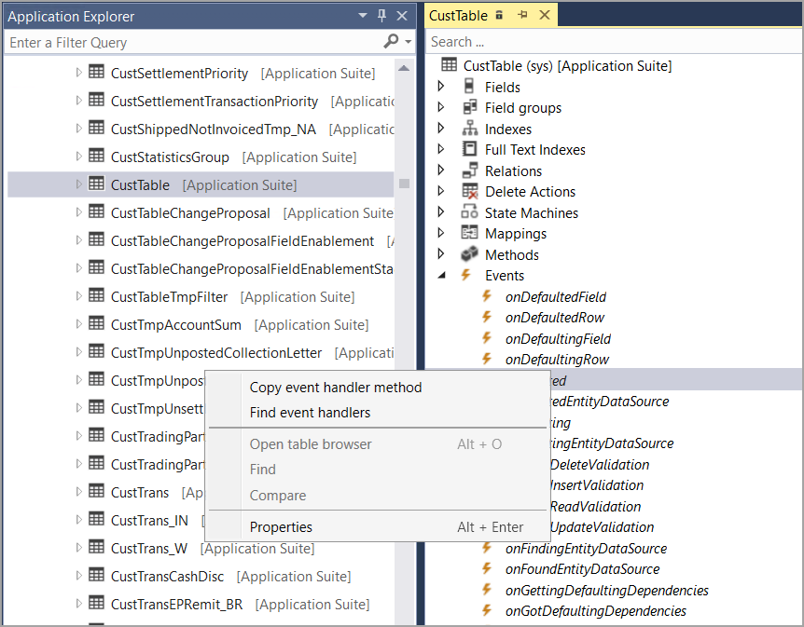
1.4 Develop code to extend a framework
To change the behavior of an element, you can create an extension of that element.
Class extensions
To extend a table's business logic, you can create an augmentation class that decorates the table with the Extension Of attribute and uses the _Extension suffix.
Event handlers
Event handlers are code that runs when an event occurs in an element.
Chain of Command
You can wrap methods in an extension class to extend the logic of public and protected methods.
1.5 Implement the SysOperationSandbox framework
You can use the SysOperationSandbox framework to run long-running processes in the web client asynchronously.
SysOperationSandbox
SysOperationSandbox allows you to run a synchronous operation on an asynchronous session in the web client.
Click here for Practice: Lab - Extend an EDT

Slide 6
2. Extend elements in finance and operations apps
Elements in finance and operations apps are customized through extensions to help you modify properties, add components, or remove controls.
In this module, you will:
Create extensions to customize finance and operations apps.
Extend a table.
Create a form extension.
2.1Introduction
Finance and operations apps development is extension-based to allow modification of application behavior and elements in a less intrusive manner.
Watch this video to see how you can create object extensions from the AOT.

Slide 7
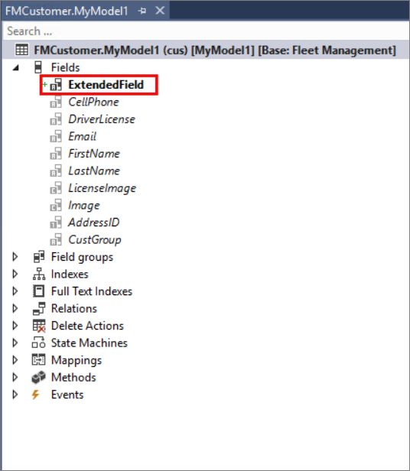
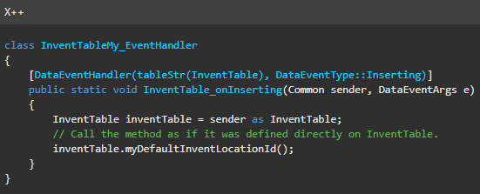
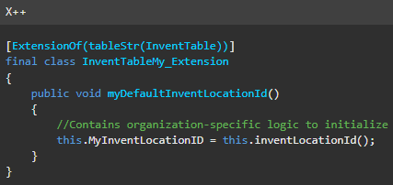
2.2 Add a table extension to a project
To modify a table, you can create an extension of the table and add fields or field groups.
Table indexes
You can add an index, relation, or change properties to an extended table.
Table business logic
To implement event handlers in an extended table, you need to create a new class that extends the table and decorates it with the [Extension Of()] attribute.

Slide 8
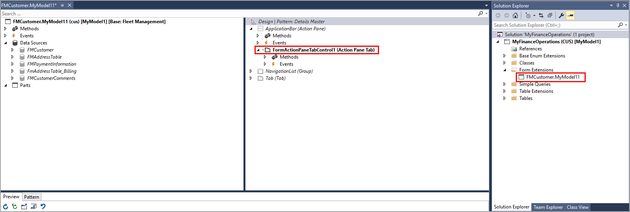
2.3 Add a form extension to a project
To add new functionality to a form, you can create an extension of the form. This allows you to add new controls, change properties, or implement event handlers.
Click here Practice Lab: Lab - Extend a form and add controls

Slide 9
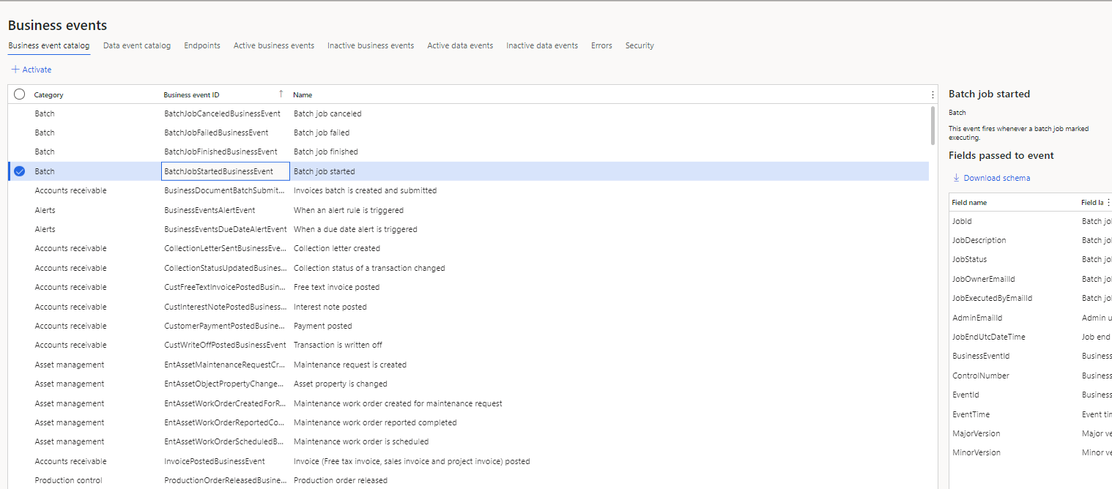
3. Consume business events in finance and operations apps
Business events provide a mechanism that lets external systems receive notifications from finance and operations apps. In this way, the systems can perform business actions in response to the business events.
In this module, you will:
Learn about the business events framework.
Implement new business events through class extension.
Business events in Microsoft Power Automate.
Role based security for business events.
3.1 Introduction
Business events are generated when a business process is run. They can be used by external systems to receive notifications from finance and operations apps.

Slide 10
3.2 Business event framework
Business events are sent regardless of their enabled status, but they can be activated.
Business event catalog
The business event catalog lists and describes all business events in the instance.
Performance
The business events framework has two primary settings that can affect performance:
Processing threads
Bundle size
The processing threads setting controls the number of threads used to process business events. The bundle size setting controls the number of events grouped together for processing by a thread.
3.3 Create a new business event
To implement a new business event, you need to create a business event class and a business events contract class, and then extend the BusinessEventsBase class.
Business events contract class
The business events contract class extends the BusinessEventsContract class and defines the payload of the business event.

Slide 11
3.4 Activate business events
Business events in the business event catalog are not active by default. You can activate them in all legal entities or in specific legal entities.
Activated business events will be processed by the system, while inactivated events will not. You can also delete inactivated business events.
Errors
Business events errors can occur during outbound processing. The system retries several times to process the event, but if all attempts are unsuccessful, the event is saved in an error log.
You can resend the event or download the payload for offline processing.
Subscribe to business events from service
Users with [Subscribe to nosiness event from service] privilege can only see and subscribe to business events that have been assigned to their roles. This is enforced by role-based security, which means that users can only subscribe to business events in the organizations to which they have access.
Backward compatibility
Role-based security for business events is disabled by default. It must be explicitly enabled in the business events catalog via the Security menu. After it is enabled, security will be enforced for all users, except for administrators. Non-administrators will only see business events that their roles were assigned to.

Slide 12
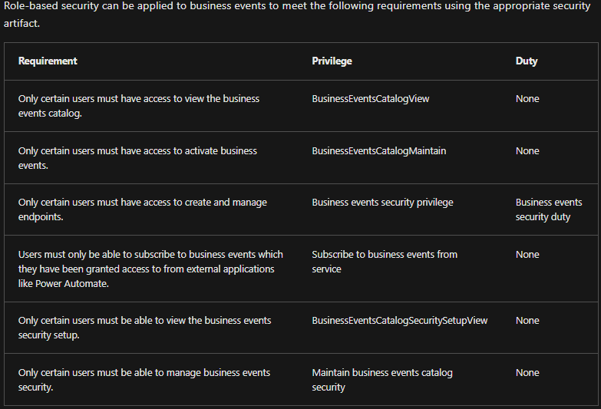
3.5 Role-based security for business events

Slide 13
3.6 Business events in Microsoft Power Automate
Business events can be consumed in Microsoft Power Automate via the application connector. The connector has a trigger that is named When a business event occurs. This trigger can be used to subscribe to any of the business events that are available in the target instance of the application.
Subscribing to business events and unsubscribing from them
When a business event happens, trigger is added to a flow, the following information must be provided:
Instance – Specify the host name of the instance where business events occur. Environment instances should be available in the provided drop-down menu, but if an environment is not listed, it can be entered as a custom value.
Category – Select the category of business events. The Business event field then shows the business events in that category.
Business event – The available business events in the selected category.
Legal entity – Specify the legal entity where the business event is being subscribed to. The flow will be triggered when the business event occurs in that legal entity. By default, this field is blank, and the business event is subscribed to in all legal entities.

